Slide 1

Face Recognition based Attendance System
By: To:
Shreya Gupta Dr. Amanpreet Kaur

Slide 2

PHOCKET INFOTECH PRIVATE LIMITED
PHOCKET is the new age intelligent lending platform, the perfect amalgamation of artificial intelligence and advance Analytics. It’s a simple and elegant money lending fintech platform which functions through mobile and website. It is 100% paperless and fully automated because we understand the need of the hour, keep it simple and quick. Phocket offers loans based on the requirement of the target audience within a span of a few minutes, with minimum documentation. Our uniqueness is that once the credit check gets completed from our end, the loan will get disbursed within a span of a few hours in the bank account of the applicant. My supervisor is Deepanshu Aggarwal – Senior App developer at Phocket

Slide 3
INTRODUCTION
To maintain the attendance record with day-to-day activities is a challenging task. The conventional method of calling name of every individual is time consuming and there is always a chance of proxy attendance. The following system is based on face recognition to maintain the attendance record of people. The daily attendance is recorded which is stored already by the administrator. As the time for corresponding subject arrives the system automatically starts taking snaps and then apply face detection and recognition technique to the given image and the recognize individual are marked as present and their attendance update with corresponding time and subject id. We have used deep learning techniques to develop this system, histogram of oriented gradient method is used to detect faces in images and deep learning method is used to compute and compare feature facial of students to recognize them. Our system is capable to identify multiple faces in real time. The main objective of this project is to develop face recognition based automated attendance system. In order to achieve better performance, the test images and training images of this proposed approach are limited to frontal and upright facial images that consist of a single face only. The test images and training images have to be captured by using the same device to ensure no quality difference. In addition, the students have to register in the database to be recognized. The enrolment can be done on the spot through the user-friendly interface.

Slide 4
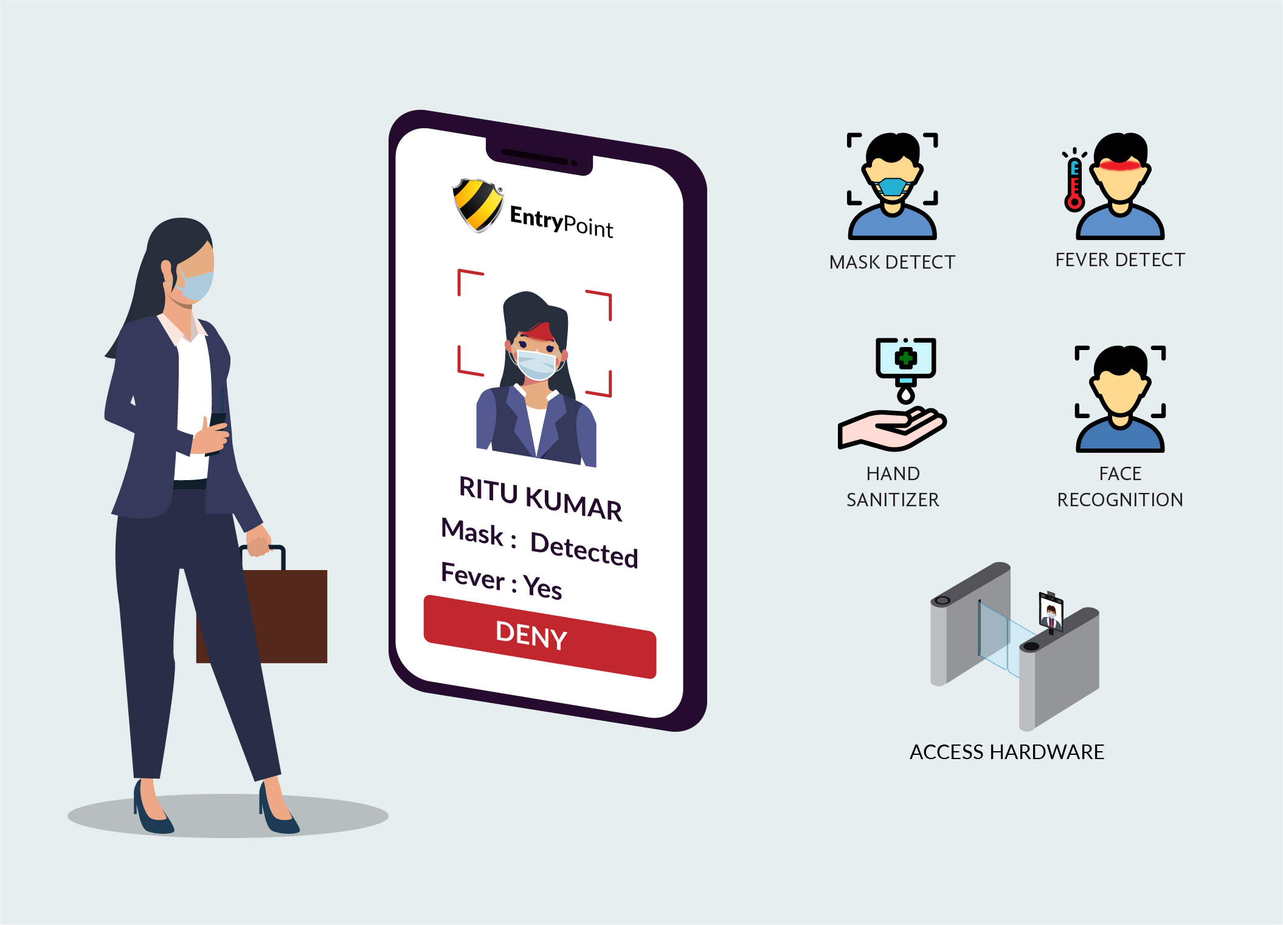
AIM
The main aim of this project is to develop an automated attendance tracking system that uses modern face recognition technology to accurately identify and record the attendance of individuals in real-time. The project aims to eliminate the need for manual attendance taking, which can be prone to errors and inefficiencies, and provide a more reliable and efficient attendance tracking system. Additionally, the system will help to ensure the safety of individuals by reducing contact during the attendance taking process.

Slide 5
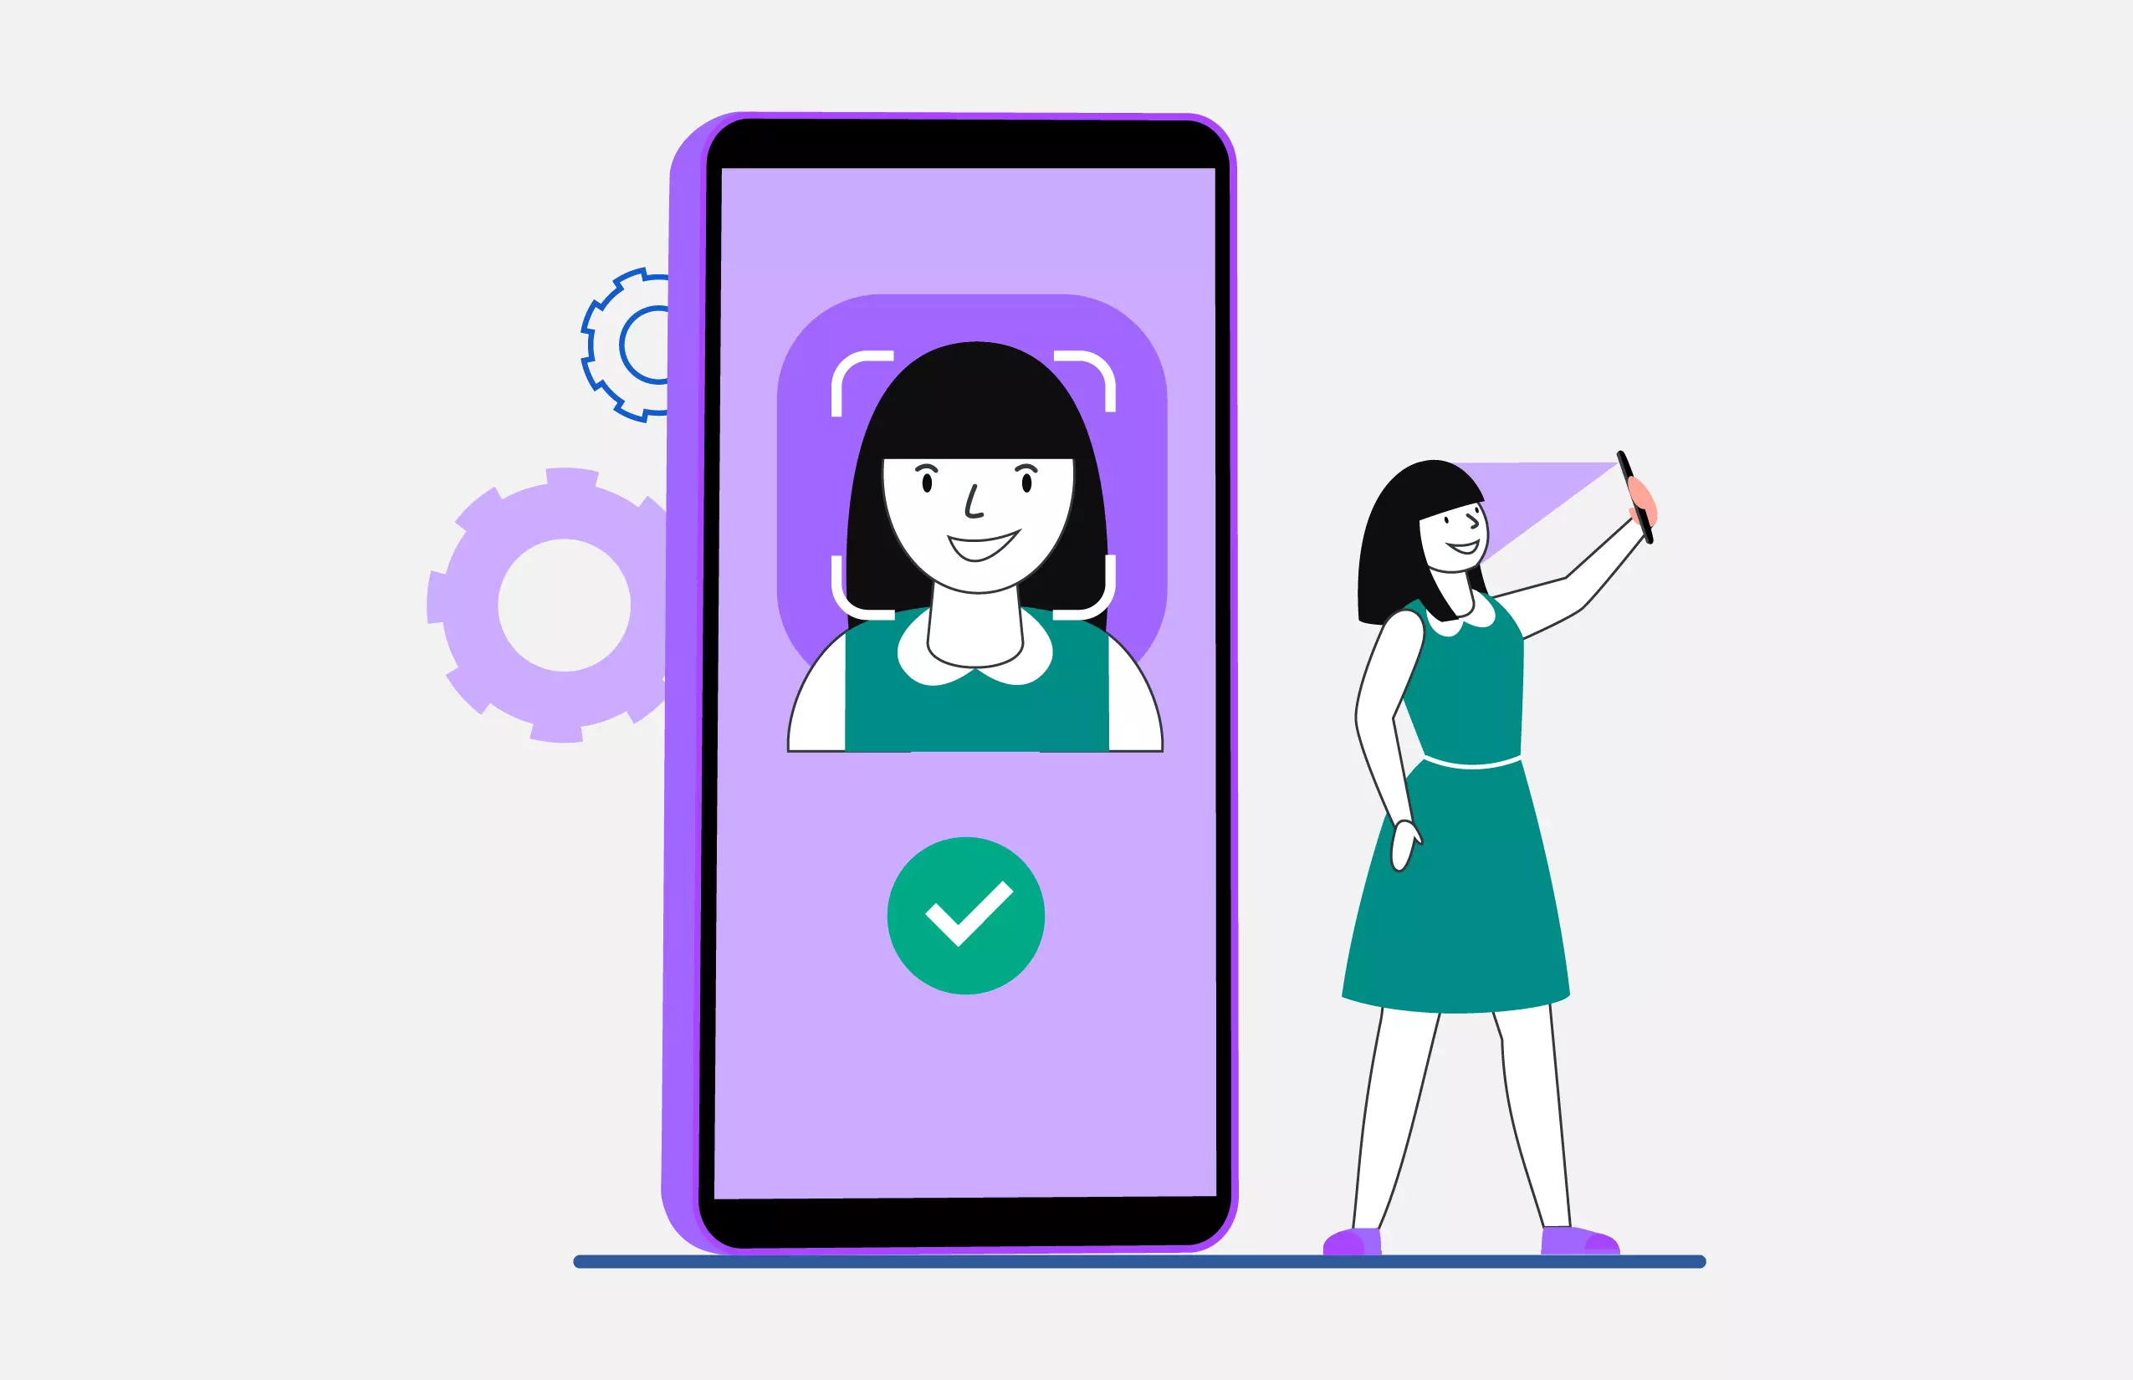
OBJECTIVE
To identify the people faces accurately. To mark the attendance automatically. To reduce the time and the efforts required for manual attendance to provide a valuable attentive system for both lecturer and students or in offices. It provides flexibility and reduces the time loss. There will be no chance for a proxy. The objective of this project is to develop face recognition based automated attendance system. Expected achievements in order to fulfill the objectives are:
• To detect the face segment from the video frame.
• To extract the useful features from the face detected.
• To classify the features in order to recognize the face detected.
• To record the attendance of the identified student.

Slide 6
PROBLEM STATEMENT
To develop an automated attendance system using face recognition. Concept In a classroom or any other field with large number of people, it is a very tedious and time-consuming task to take the attendance manually. Therefore, we can implement an effective system which will mark the attendance of individuals automatically by recognizing their faces. The process of this face recognition system is divided into various steps, but the important steps are detection of face and recognition of face. Firstly, to mark the attendance of people, the image of their’ faces will be required. This image can be snapped from the camera device, which will be placed in the classroom or hall at a suitable location from where the whole room can be covered. This image will act as input to the system. For the effective face detection, the image needs to be enhanced by using some image processing techniques like grayscale conversion of image and histogram equalization. To identify the people sitting on the last rows neatly, the histogram equalization of image needs to be done. Hence, there is a need to develop a real time operating student attendance system which means the identification process must be done within defined time constraints to prevent omission. The extracted features from facial images which represent the identity of the students have to be consistent towards a change in background, illumination, pose and expression. High accuracy and fast computation time will be the evaluation points of the performance.

Slide 7
PROPOSED SYSTEM
All the people of the room must register themselves by entering the required details and then their images will be captured and stored in the dataset. During each session, faces will be detected from live streaming video of room. The faces detected will be compared with images present in the dataset. If match found, attendance will be marked for the respective person. The task of the proposed system is to capture the face of each individual and to store it in the database for their attendance. The face of the people needs to be captured in such a manner that all the feature of the their' face needs to be detected, even the seating and the posture need to be recognized. There is no need for the administrator to manually take attendance in the room because the system records a video and through further processing steps the face is being recognized and the attendance database is updated.
Attendance data is securely saved in a database and can be retrieved and analyzed in real time to create attendance records and analytics. The suggested strategy has the ability to transform the attendance process while also increasing the general efficacy and effectiveness of educational and business organizations.
This model could also come with other features including support for numerous cameras and image capture devices, real-time attendance tracking, interaction with other systems and programs, and support for other applications and systems. In general, the suggested model seeks to offer a trustworthy and effective alternative for attendance administration throughout a range of contexts, including schools, universities, businesses, and other organizations.

Slide 8
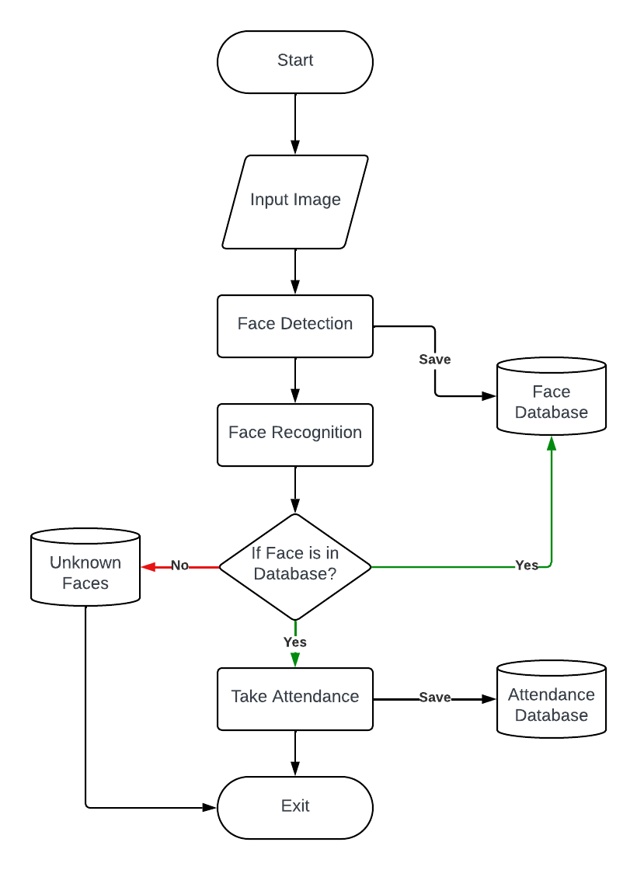
FLOW CHART

Slide 9
IMPLEMENTATION
The main components used in the implementation approach are open source computer vision library (OpenCV). One of OpenCV’s goals is to provide a simpleton-use computer vision infrastructure that helps people build fairly sophisticated vision applications quickly. OpenCV library contains over 500 functions that span many areas in vision. The primary technology behind Face recognition is OpenCV. The user stands in front of the camera keeping a minimum distance of 50cm and his image is taken as an input. The frontal face is extracted from the image then converted to gray scale and stored. The Principal component Analysis (PCA) algorithm is performed on the images and the eigen values are stored in an xml file. When a user requests for recognition the frontal face is extracted from the captured video frame through the camera. The eigen value is re-calculated for the test face and it is matched with the stored data for the closest neighbor.
SOFTWARE DEVELOPMENT
The software development area has two main system flows:
The face database was established.
The procedure for recording attendance
SOFTWARE REQUIREMENTS
Visual Studio Code
Microsoft Office
Tkinter
HARDWARE REQUIREMENTS
Laptop with 8 GB RAM or above
Camera 720p or above

Slide 10
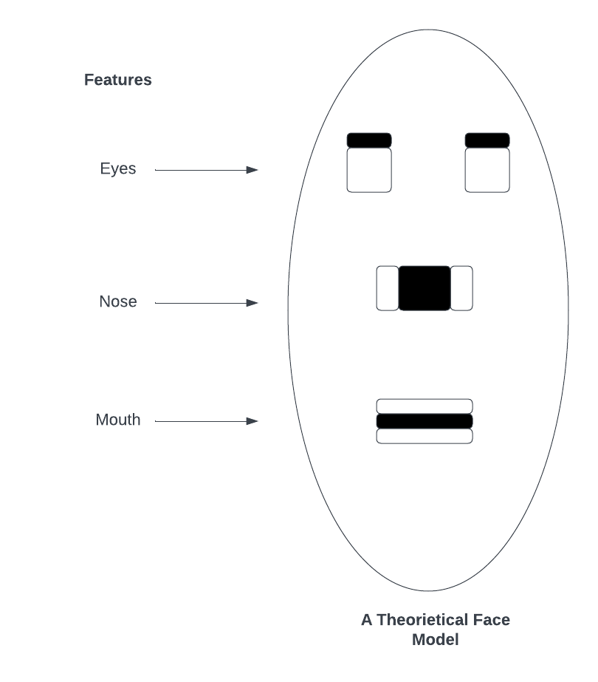
ALGORITHM USED
Haar Cascade : It is a machine learning based approach where a cascade function is trained from a lot of positive and negative images (where positive images are those where the object to be detected is present, negative are those where it is not). It is then used to detect objects in other images. Luckily, OpenCV offers pre-trained Haar cascade algorithms, organized into categories (faces, eyes and so forth), depending on the images they have been trained on.
LBPH: Local Binary Pattern (LBP) is a simple yet very efficient texture operator which labels the pixels of an image by thresholding the neighborhood of each pixel and considers the result as a binary number. It has further been determined that when LBP is combined with histograms of oriented gradients (HOG) descriptor, it improves the detection performance considerably on some datasets.

Slide 11
LIBRARY USED
OpenCV Library :OpenCV (Open-Source Computer Vision Library) is an open-source computer vision and machine learning software library. OpenCV was built to provide a common infrastructure for computer vision applications and to accelerate the use of machine perception in the commercial products. Being a BSD-licensed product, OpenCV makes it easy for businesses to utilize and modify the code.
NumPy package : NumPy is a Python package which stands for 'Numerical Python'. It is the core library for scientific computing, which contains a powerful n-dimensional array object, provide tools for integrating C, C++ etc. It is also useful in linear algebra, random number capability etc.
Pandas Library : Pandas is a high-level data manipulation tool developed by Wes McKinney. It is built on the NumPy package and its key data structure is called the Data Frame. Data Frames allow you to store and manipulate tabular data in rows of observations and columns of variables.
Tkinter Module : Tkinter is the standard GUI library for Python. Python when combined with Tkinter provides a fast and easy way to create GUI applications. Tkinter provides a powerful object-oriented interface to the Tk GUI toolkit.
Time Module : Python has a module named time to handle time related task. To use functions defined in the module, we need to import the module first.
Date Module : A date in python is not a date type of its own, but we can import a module named date time work with dates as a date objects.

Slide 12
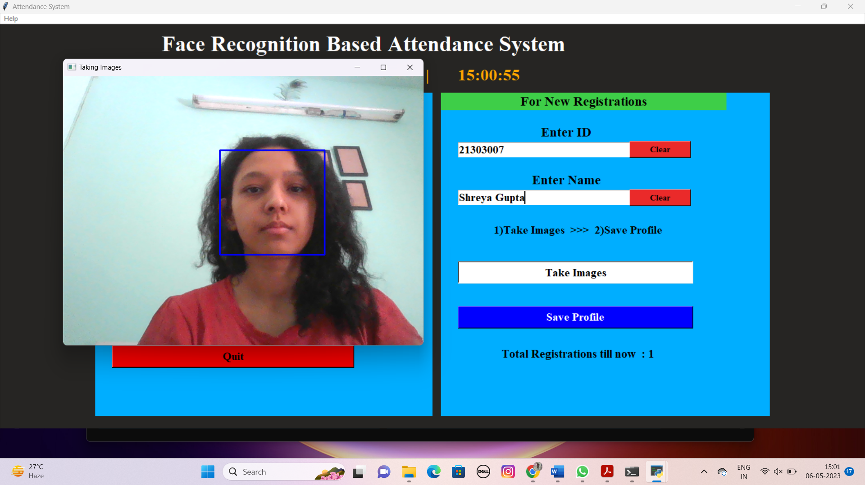
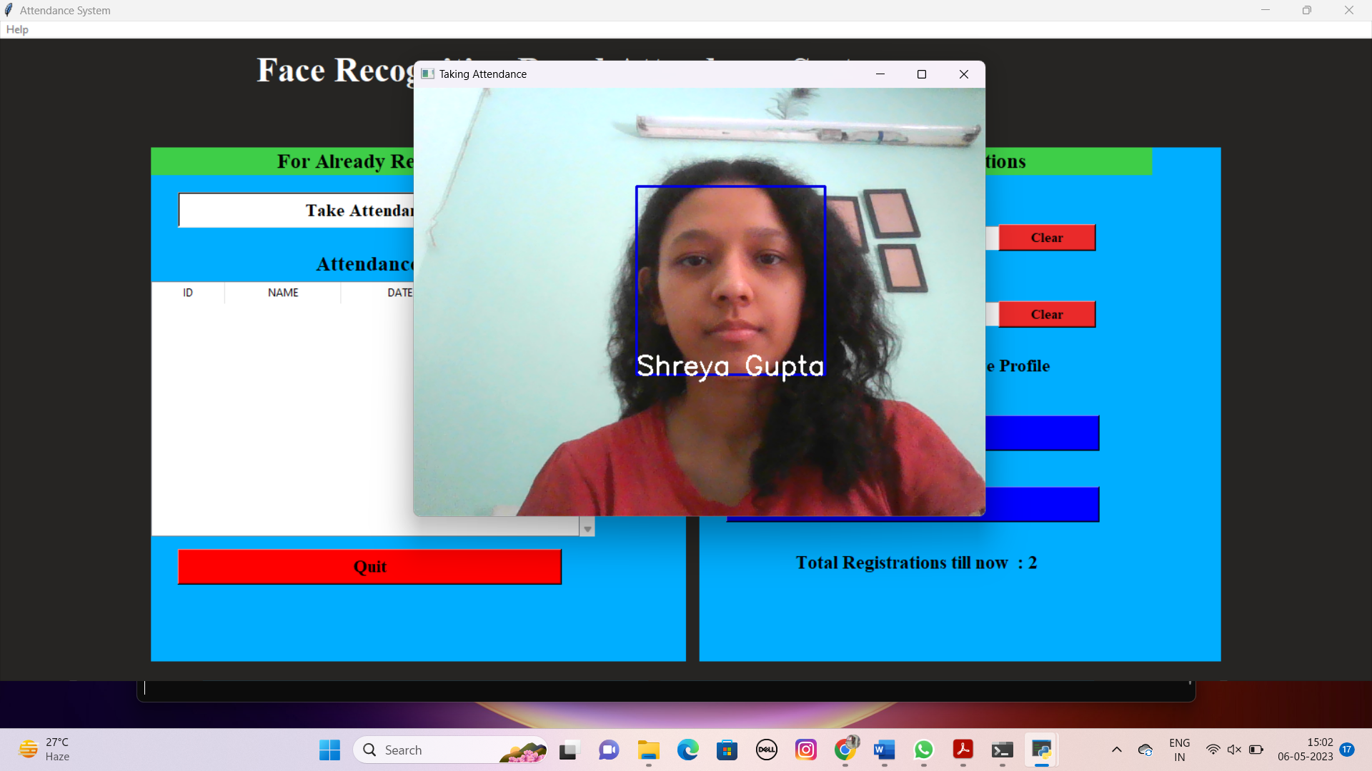
RESULTS
1. Saving profile
2. Recognizing the person

Slide 13
ADVANTAGES AND DISADVANTAGES
Advantages
Disadvantages
Accuracy: Face recognition technology can achieve high accuracy rates, making it reliable for attendance tracking.
Efficiency: Automated face recognition systems can process attendance quickly and efficiently. Students or employees can simply stand in front of a camera, and their attendance is recorded without the need for physical contact or manual input.
Elimination of Proxy Attendance: Face recognition technology helps prevent proxy attendance, where someone signs in on behalf of another person.
Scalability: Face recognition systems can handle large volumes of attendance data, making them suitable for organizations with a high number of employees or students.
Integration: Python, being a versatile and widely-used programming language, allows for seamless integration of face recognition technology with existing systems or applications.
Privacy Concerns: Facial recognition involves the capture and storage of individuals' biometric data, which raises privacy concerns. Some people may feel uncomfortable with their facial data being stored and used for attendance tracking.
Environmental Constraints: The effectiveness of face recognition systems can be impacted by environmental factors such as lighting conditions, camera quality, and angles.
Cost: Implementing a face recognition system can involve significant costs, including hardware (e.g., cameras, servers) and software development.
Algorithm Bias: If the system is not trained on diverse datasets or if the algorithms are biased, it can lead to inaccurate attendance tracking and potential discrimination.
False Positives/Negatives: This technology has improved significantly, it is not 100% foolproof. There can still be instances of false positives (incorrectly recognizing someone) or false negatives (failing to recognize someone), which can impact attendance accuracy.

Slide 14
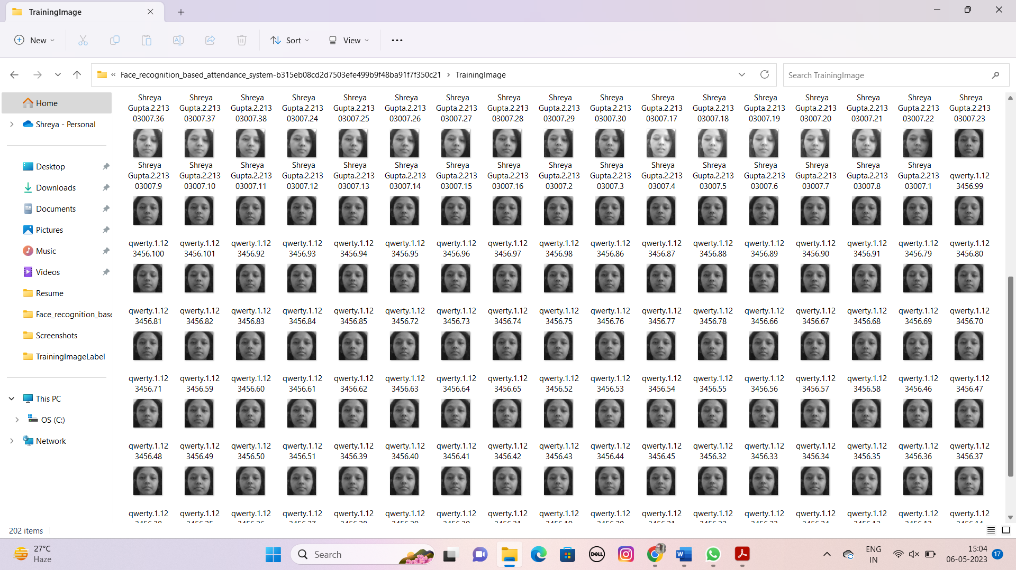
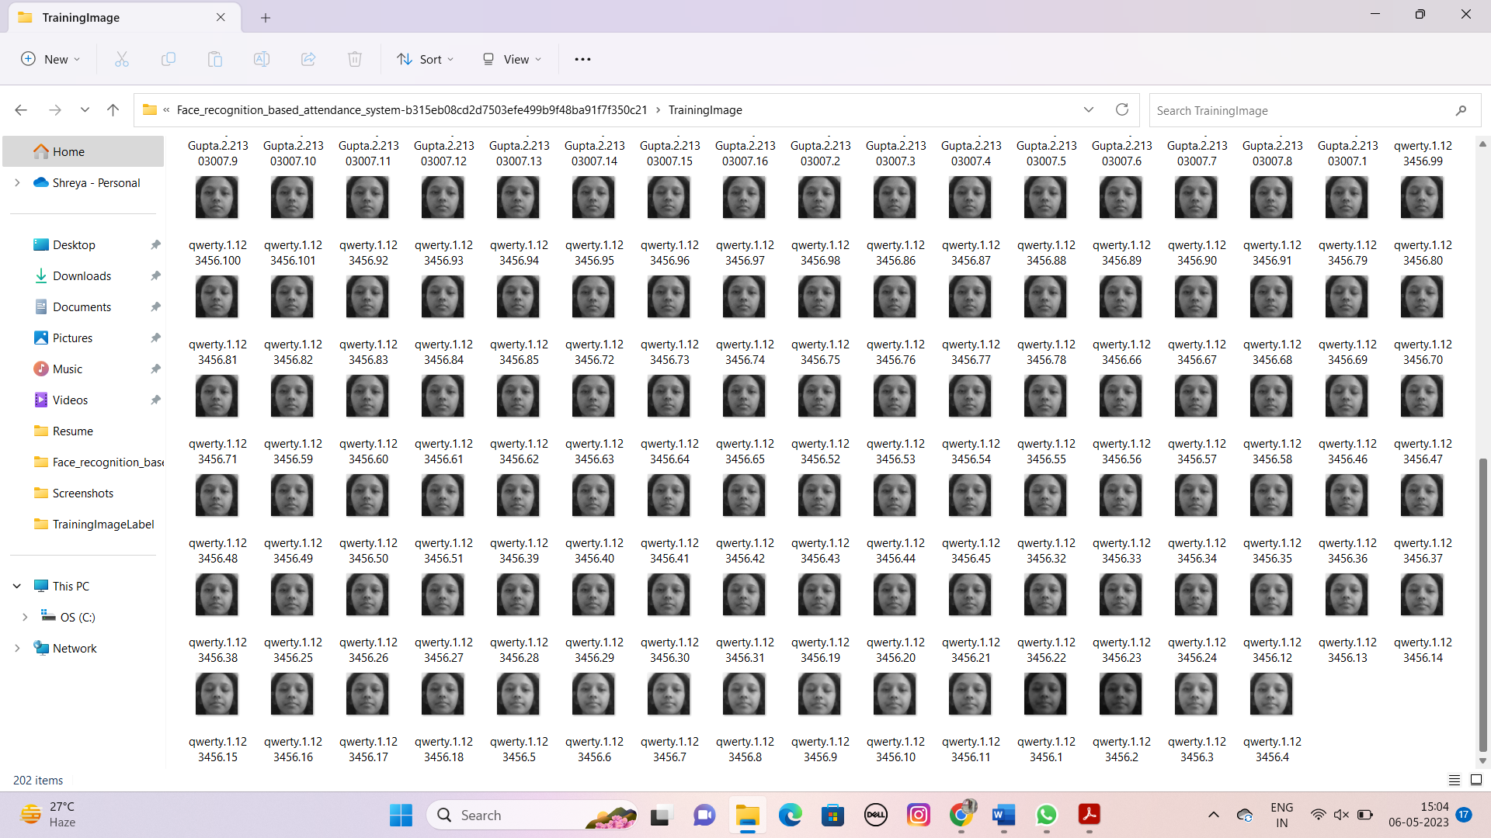
EVALUATION
We performed a set of experiments to demonstrate the efficiency of the proposed method. 30 different images of different people are used in training set. A sample binary image detected by the Recognizer() function using Face extracting Frame work detection method.
Face Position | Detecting face | Recognising face
0 ̊ | 97.3 % | 93 %
18 ̊ | 82 % | 76 %
54 ̊ | 52.8 % | 55 %
72 ̊ | 0 % | 0 %
90 ̊ | 0 % | 0 %

Slide 15
PERFORMANCE ANALYSIS
Here we consider one constant parameter intensity of light . we performed different experiments on different distance and different angles. We observed the confidence level at the different positions by gradually increasing the distance .we plotted the graph using the x and y coordinates by considering the x values as the confidence level or accuracy rate. and y values as the distance (cms).

Slide 16
CONCLUSION
Automated Attendance System has been envisioned for the purpose of reducing the errors that occur in the traditional (manual) attendance taking system. The aim is to automate and make a system that is useful to the organization such as an institute. The efficient and accurate method of attendance in the office environment that can replace the old manual methods. This method is secure enough, reliable and available for use. No need for specialized hardware for installing the system in the office. It can be constructed using a camera and computer. In this system we have implemented an attendance system for a lecture, section or laboratory by which lecturer or teaching assistant can record students’ attendance. It saves time and effort, especially if it is a lecture with huge number of students. Automated Attendance System has been envisioned for the purpose of reducing the drawbacks in the traditional (manual) system. This attendance system demonstrates the use of image processing techniques in classroom. This system can not only merely help in the attendance system, but also improve the goodwill of an institution.

Slide 17
LIMITATIONS
Absence Of Adequate Federal Restrictions: Demand for face recognition has dramatically increased. This technology's market is expanding rapidly. One of the main issues for the populace is the absence of adequate government rules. They are concerned about the invasion of their privacy, incomplete accuracy, and skewed or incorrect outcomes.
Error in Identity: This technology are using now-a-day several law maintain organizations and departments to find offenders and do other searches. However, since people are already concerned about the system's results' partial accuracy, this could result in misidentification.
Infringement against UN Human Rights: The UN has acknowledged the human rights concept that surveillance should only be used when it is appropriate and required. Instead of enabling others to inadvertently interfere with other people's freedom and fundamental rights, it indicates that monitoring should only be used in cases of serious wrongdoing.
Negative impact on public event attendance by citizens: A lack of active attendance and engagement in public events, such as political campaigns and protests, may be caused by citizens' suspicion of this technology and the government's intentions in employing it.
Can be utilized to target additional, more exposed areas of the building: Security of individuals, monitoring and tracking of lawbreakers, keeping track of employee attendance and working hours, and many more uses are all made possible by facial recognition technology. On the other side, it may also be applied to target certain societal groups in an effort to undermine them.

Slide 18
FUTURE WORK
The system here is simply intended to track people attendance in room. However, this system will improve and adapt in many different ways which includes multinational corporations for the maintenance of the surveillance huge repository, filled with a sizable no. of data of the employees doing job in a specific organization. This will be able to aid in maintaining security and also allow the business to check over their employees whether they are able to work for required number of hours each day. Banks may also use this strategy. The ATMs could acquire this system. Only once the clients' faces have been recognized by the ATM machine through comparison with photographs that have already been recorded in the database would they be permitted to access their bank accounts. This might contribute to reducing money thefts and boosting ATM security.
On this project, there are still a few tasks that need to be finished in order to notify the student via SMS about his or her their attendance. By using a GSM module, this is made possible. The parent of the pupil receives this SMS notification. The technique that has been provided is meant solely for testing because it is not entirely trustworthy.

Slide 19

Thank you

